Slide 1


Name- Sathvik Shetty
Predictive Modelling for Insurance Claim Probability Based on Comprehensive Car Policy Features and Safety Ratings
Batch- Master in Data Science and AI

Slide 2


Content
Introduction
Problem Statement
Tools
Data Overview
Data Preprocessing
Model Selection and Training
Model Evaluation
Conclusion

Slide 3

Introduction
The car insurance industry is a highly competitive market where accurate risk assessment and pricing are crucial for insurers to remain profitable.
With the increasing number of vehicles on the road, the frequency and severity of accidents are also on the rise, resulting in higher claims costs for insurers.
To stay ahead in this competitive landscape, insurers need to leverage advanced analytics and machine learning techniques to better assess risk and price policies accurately.

Slide 4
Problem Statement
Accurately Predicting Car Insurance Claim Probability:-
Current methods rely on simplistic actuarial tables, leading to inaccurate risk assessment and inefficient pricing.
Develop a predictive model to identify key factors influencing claim frequency and severity within a 6-month period.
Enable insurance companies to better assess risk and determine fair premiums for policyholders.

Slide 5
Tools
Python
Jupyter Notebook
Pandas
NumPy
scikit-learn
Matplotlib
Seaborn
scikit-learn metrics (for model evaluation)

Slide 6
Data Overview
Dataset: Insurance Policyholders and Claims.
Size: 58592 policyholders, 6.4% claims
Variables: 44
Data Types:
Numerical: 16 (e.g., policy_tenure, age_of_car, max_torque, displacement)
Categorical: 28 (e.g., area_cluster, Make, segment, fuel_type)
The depended variable in this insurance project is: is_claim
This variable indicates whether an insurance claim has been filed for the car policy (1 = claim filed, 0 = no claim filed).

Slide 7
Data Preprocessing
No missing values in a Dataset.
Outlier detection - age_of_car, age_of_policyholder features
Handled using IQR Technique.
Feature Engineering
Torque-Power Ratio(TPR):
TPR=max torque(Nm)/Max Power(kW)
Note :- 1kW=1bhp*0.7457
Weighted Volume:-
Weighted Volume = length*width*height*gross weight

Slide 8
Contd
Areas:-
Polulation_Density >=30k -- Premium areas
30k < Polulation_Density >10k -- Plus areas
Polulation_Density <= 10k -- Basic areas
Handle Categorical Feature using One Hot Encoder.
Feature Importance
1. Policy tenure
2. Areas
is the most significant factor in predicting claims, according to statistical tests.

Slide 9
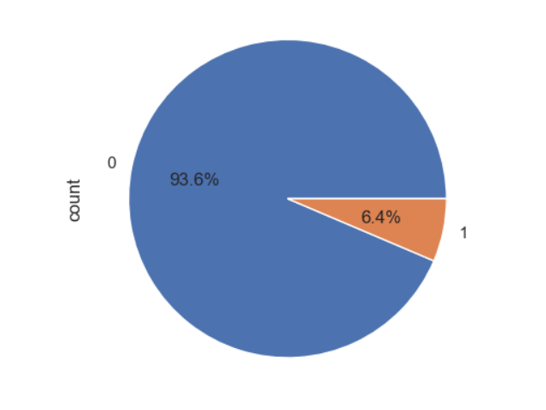
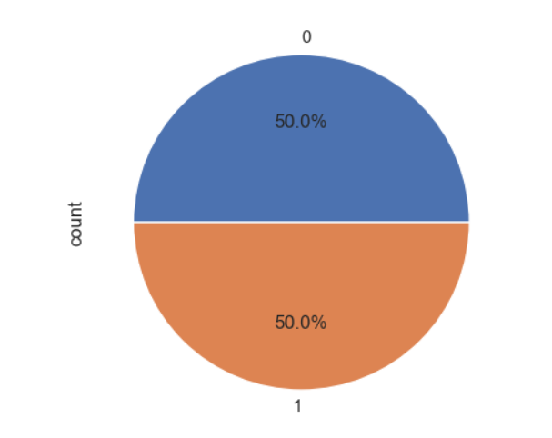
Contd
Scaled features using StandardScaler method
Imbalanced data handle by SMOTE Technique

Slide 10
Model Selection and Training
Model:
AdaBoost Classifier
GradientBoosting Classifier
XGBoost Classification
Bagging Classifier
RandomForest Classifier
Logistic Regression
Training:
Split data into training (80%) and testing sets (20%)
Train the model on the training set

Slide 11
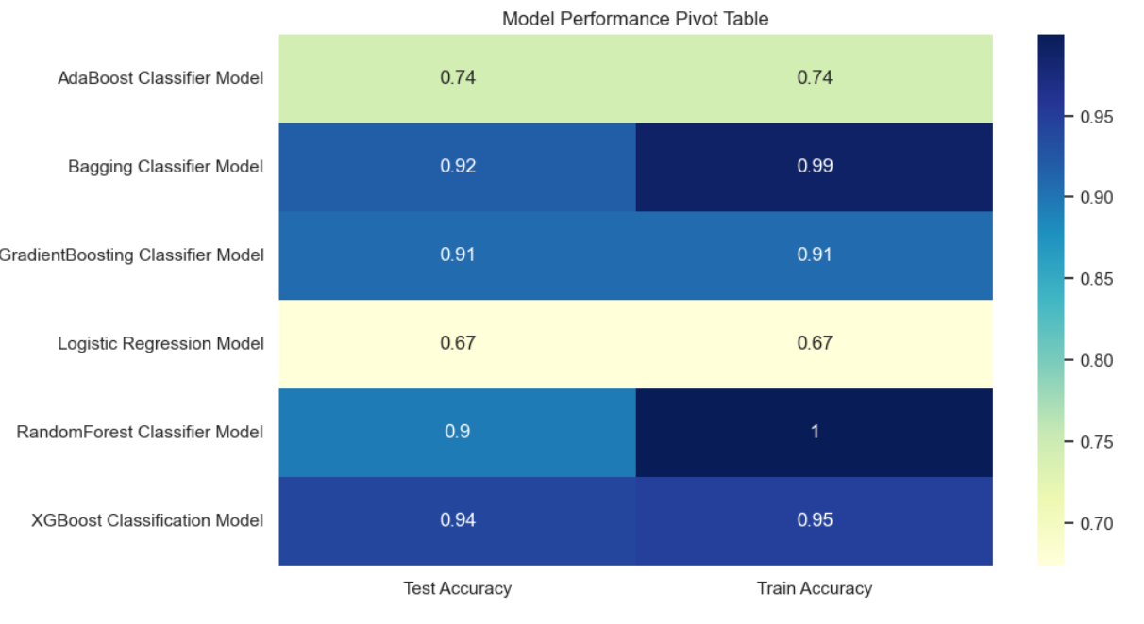
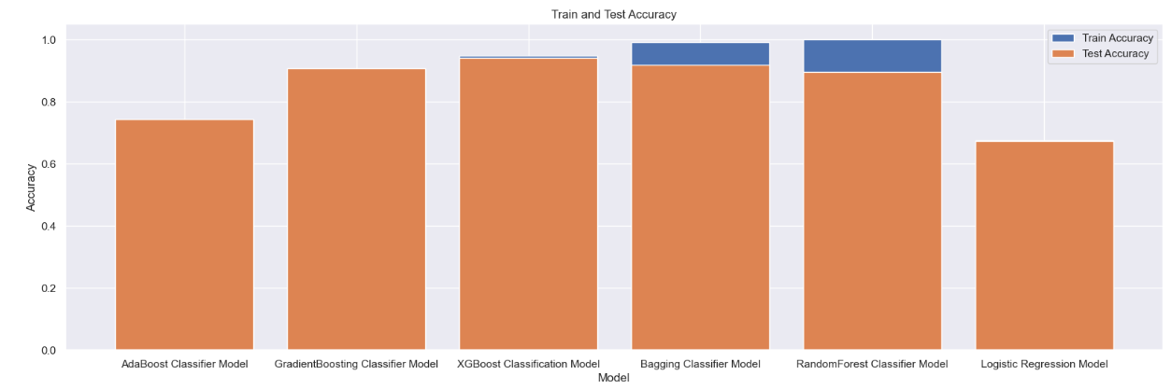
Model Evaluation

Slide 12
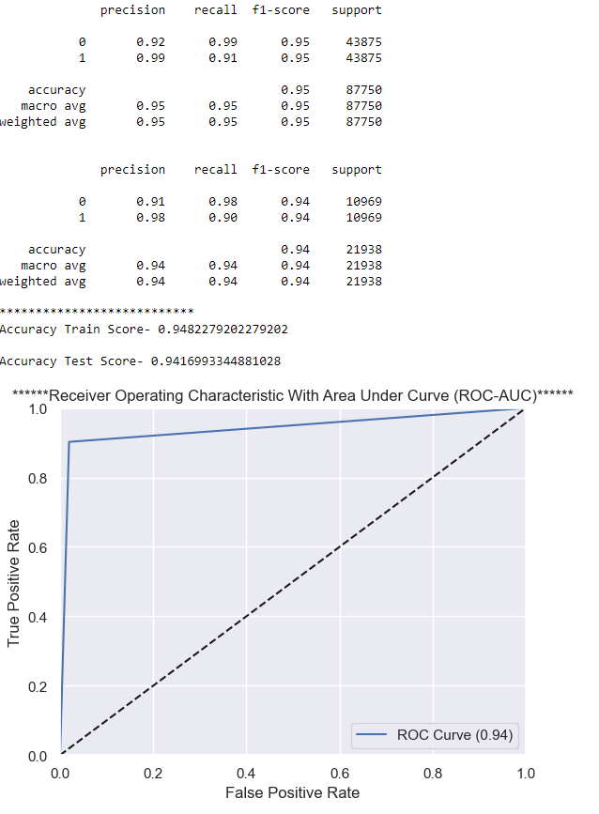
Considering the metrics, XGBoost seems to be a better choice because:-
Its test accuracy is closer to its train accuracy, indicating less overfitting
Its precision, recall, and F1-score are more balanced between the two classes.
Its weighted average metrics are higher than RandomForest's
After Performing hyperparameter tuning and cross-validation to ensure that the model is not overfitting or underfitting.

Slide 13
Conclusion
Using XGBoost Model, we developed a predictive model that accurately assesses claim probability for car insurance policies.
The model identifies key factors like vehicle features , areas and policy details that influence claim frequency and severity.
With an accuracy of 94%, this model enables insurance companies to better assess risk and determine appropriate premiums.

Slide 14
THANK YOU

